Slide 1
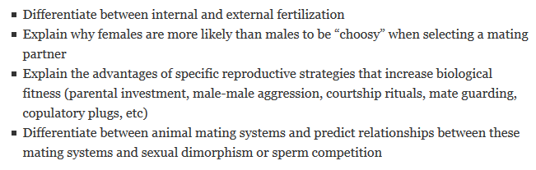
Animal Reproduction
In a world without sex, there would be no males and females. No flowers, no insects specialized in pollinating them, no extravagant colour and form like the peacock’s tail, and much animal behavior would not exist. – Rolf Hoekstra
Learning Objectives:
Notes:
Sexual reproduction in animals consists of three fundamental steps:
gametogenesis (making gametes)
mating (getting gametes together)
fertilization (fusing gametes).

Slide 2
Animal Reproduction
Asexual
Both
Sexual
Budding
Fragmentation
Polyembryony
Parthenogenesis
External fertilization
Internal fertilization
Competition
Courtship
Parental investment
Synchronized gamete release

Slide 3
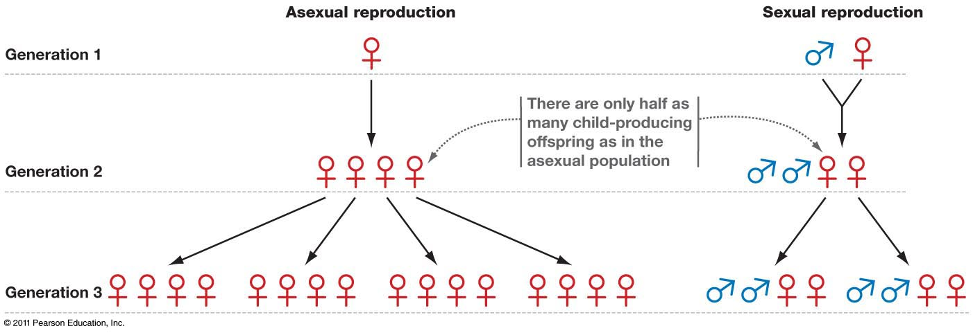
Two-fold cost of males
Freeman 4e 12.12
Notes:
Compare the number of individuals in a growing population under each strategy. increasing # in left panel, constant numbers in right panel. Why do we just count the females? 1 vs 10 females will affect the number of offspring in next generation, but 1 vs 10 males doesn’t matter because one male can feasibly fertilize all eggs (in typical species)

Slide 4
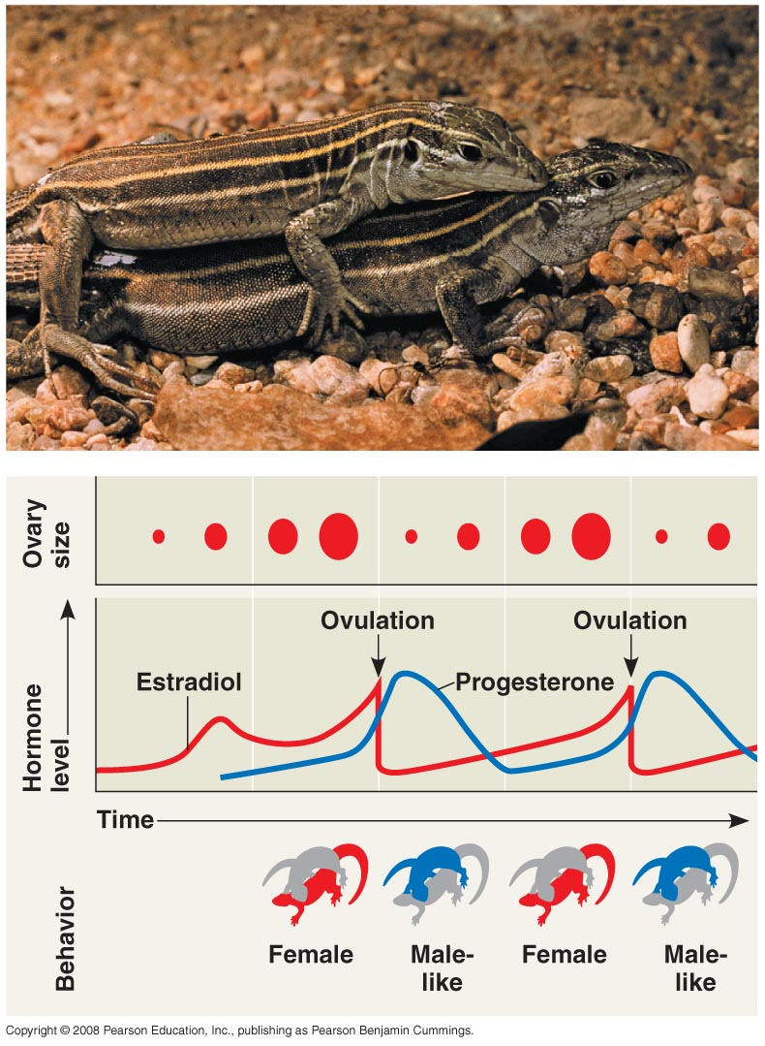
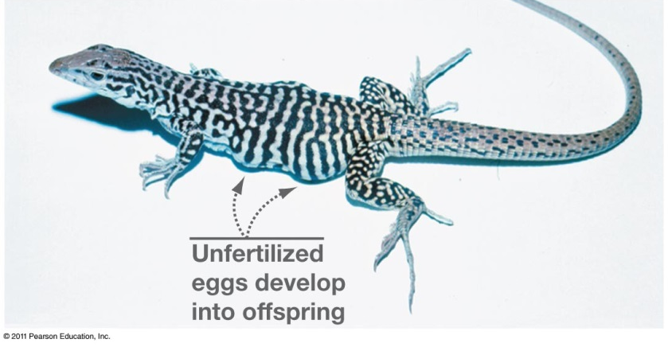
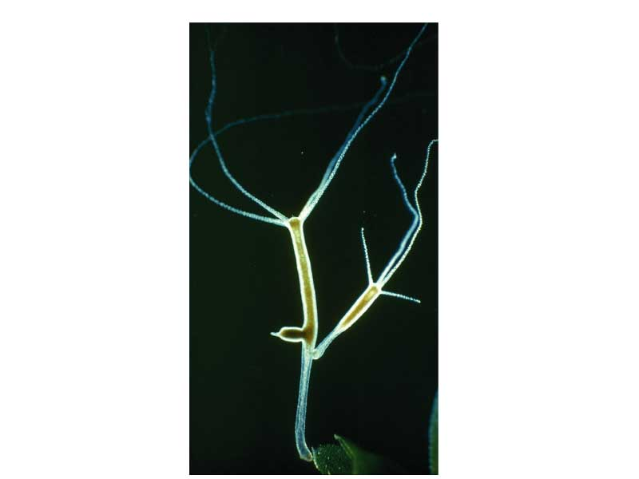
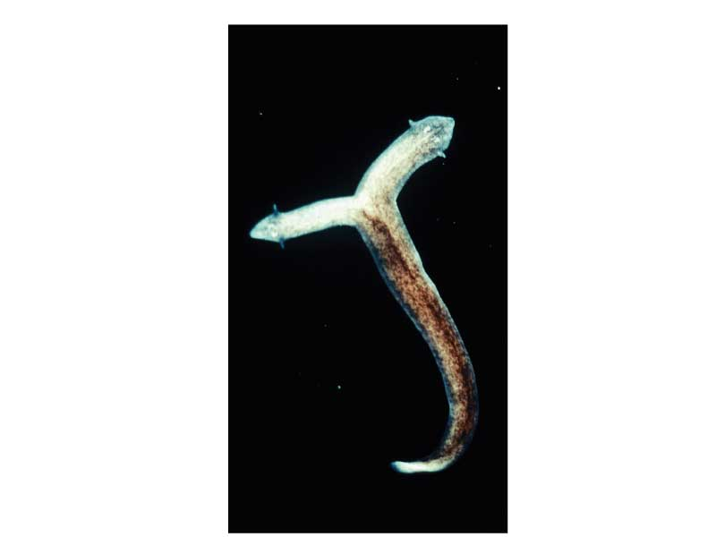
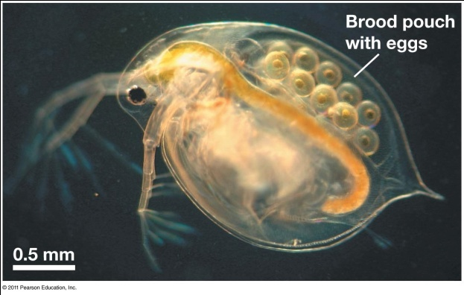
Asexual reproduction
Psuedo-mating between females

Slide 5

What does this have anything to do with Biology?
The Parthenon, Athens (Greece)
Temple to the Virgin Goddess of Knowledge, Athena
partheno- = maiden in Greek, hence parthenogenesis, or birth without fertilization

Slide 6
Animal Reproduction
Asexual
Both
Sexual
Budding
Fragmentation
Polyembryony
Parthenogenesis
External fertilization
Internal fertilization
Competition
Courtship
Parental investment
Synchronized gamete release

Slide 7
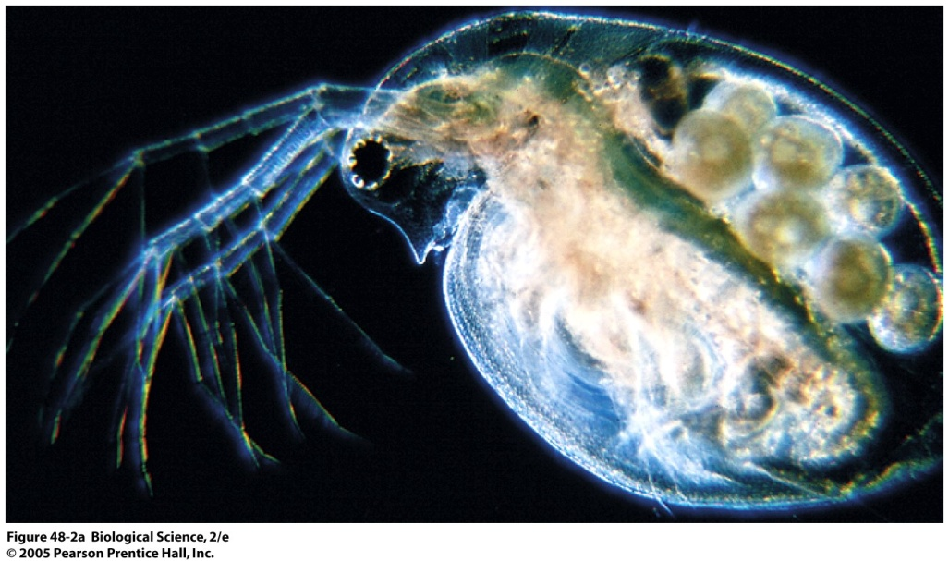
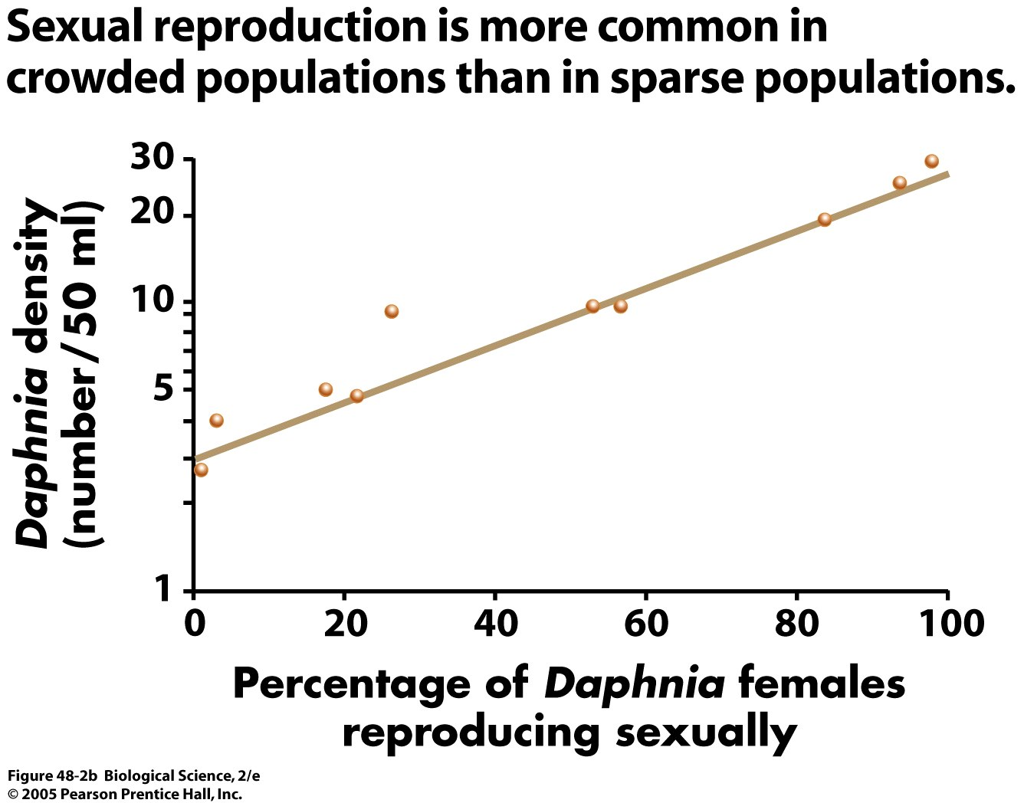
Responding to environmental cues
In spring and summer, Daphnia produce diploid daughters (mitosis!)
By early fall, Daphnia begin producing haploid eggs (meiosis!)
Haploid eggs mature into males, which can fertilize other haploid eggs (diploid resting eggs delay hatching until following spring)
Further research has shown food scarcity and shorter days also trigger switch

Slide 8
Animal Reproduction
Asexual
Both
Sexual
Budding
Fragmentation
Polyembryony
Parthenogenesis
External fertilization
Internal fertilization
Competition
Courtship
Parental investment
Synchronized gamete release

Slide 9
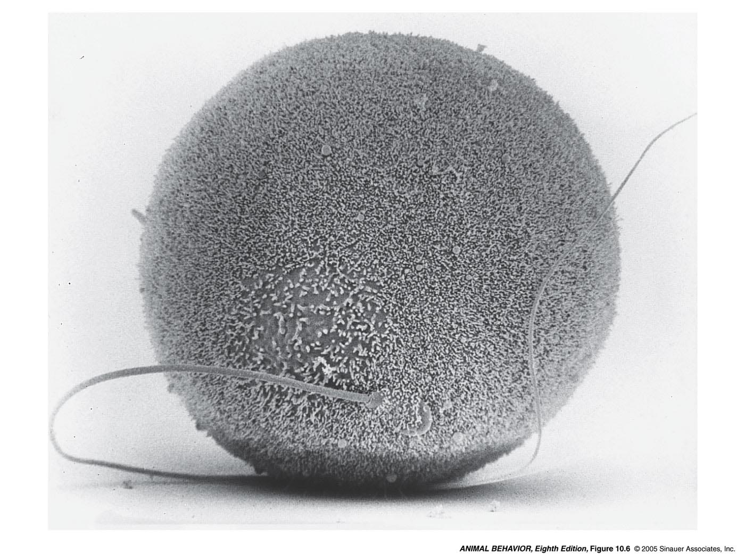
Natural selection shapes the strategy for fitness
Biological fitness: ability to produce successful offspring, relative to others in the population
Parental Investment: any investment that increases the offspring’s chances of survival at the cost of the parent’s ability to invest in other offspring
What are the limits on an individual’s reproductive potential?
The sex that invests more is limited by access to resources for investment
The sex that invests less is limited by ability to mate with the sex that invests more
Egg yolk, “nuptial” gifts (food, spermatophore), internal/external egg incubation, brood rearing, male cannibalism…

Slide 10
Animal Reproduction
Asexual
Both
Sexual
Budding
Fragmentation
Polyembryony
Parthenogenesis
External fertilization
Internal fertilization
Competition
Courtship
Parental investment
Synchronized gamete release

Slide 11
Internal or external fertilization?
External fertilization
Most external fertilizers are aquatic
Tend to produce large numbers of gametes
Synchronous gamete release is necessary
Internal fertilization
Occurs in most terrestrial animals, some aquatic ones
Can involve copulation or spermatophore transfer
Leads to several forms of sexual selection among males
Sperm competition: does the advantage go to the first or second male?
What can a male do to ensure his success in fertilizing offspring?
Notes:
11
In sexually reproducing indiv, more than one way to achieve fertilization.
External …[Examples include frogs, fish]
Internal …[explain what a spermatophore is, describe how organism picks up spermatophore, can store it for hours/days, and eat the unused portion (good protein)]
Fierce competition betw males with internal fertilization systems. Consider when multiple males mate with the same female. What can the male do to ensure high success in fertilizing offspring? [ask students for ideas]

Slide 12
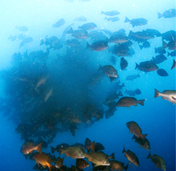
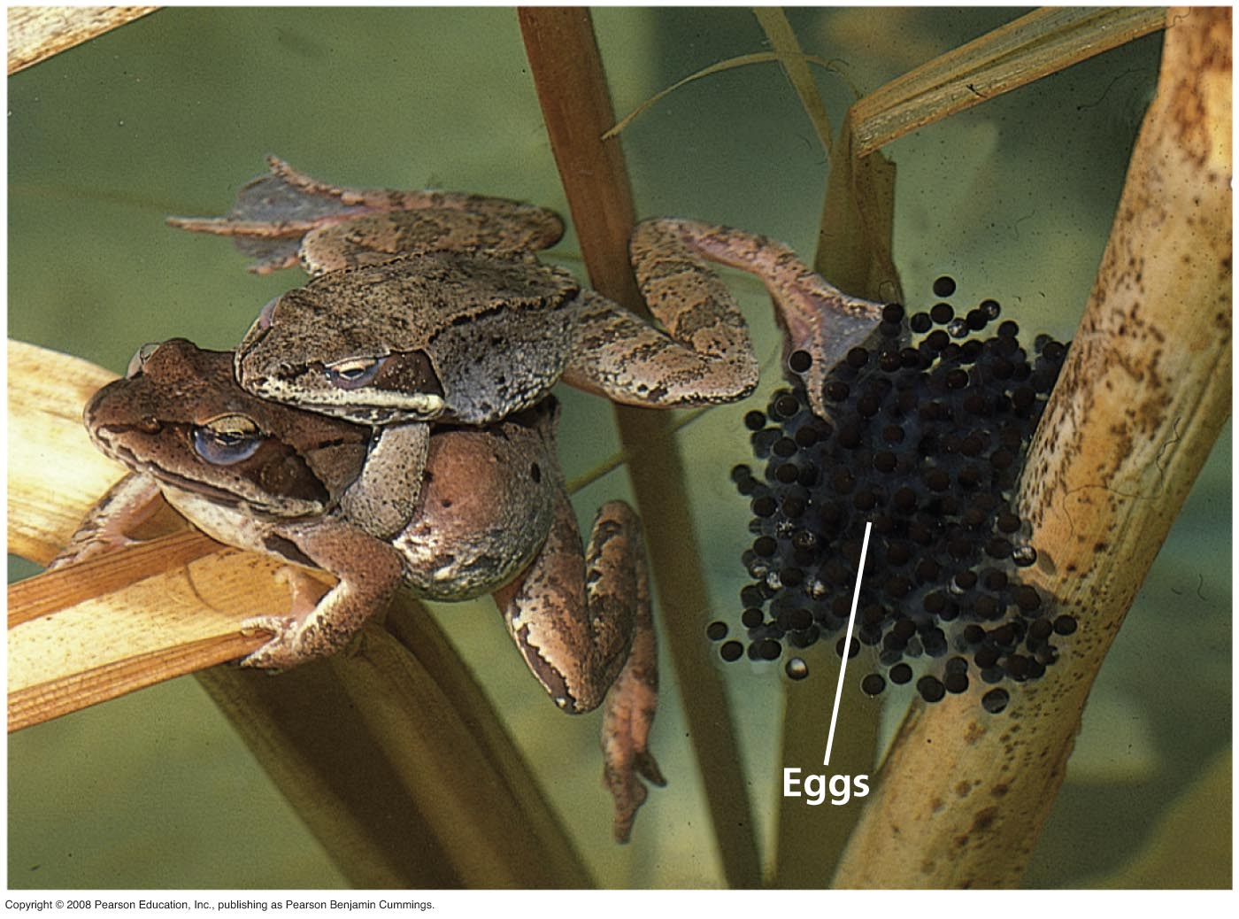
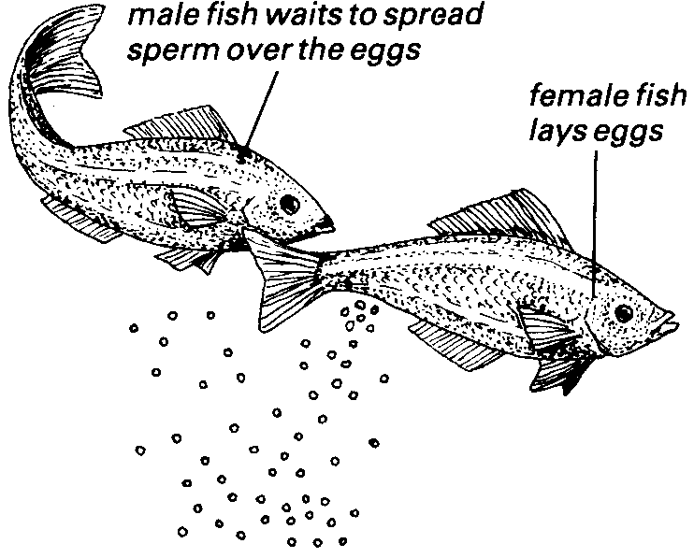
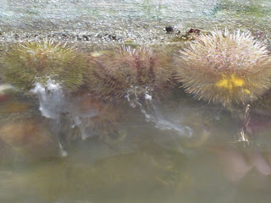
External Fertilization
Timing of gamete release, courtship, competition, parental investment
Notes:
Why should there be selection for a female to ‘care’ what males fertilizes her eggs, even in externally-fertilizing species?

Slide 13
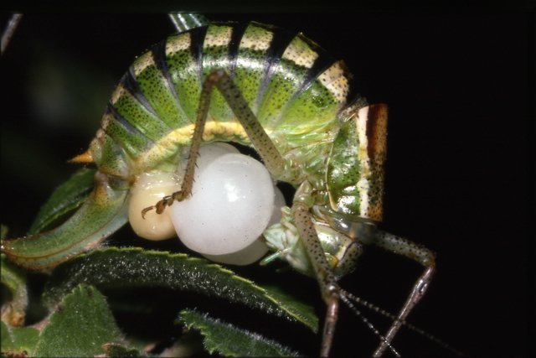
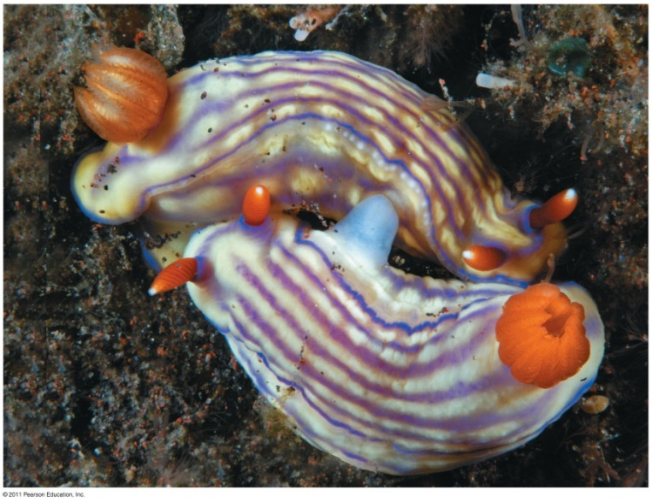
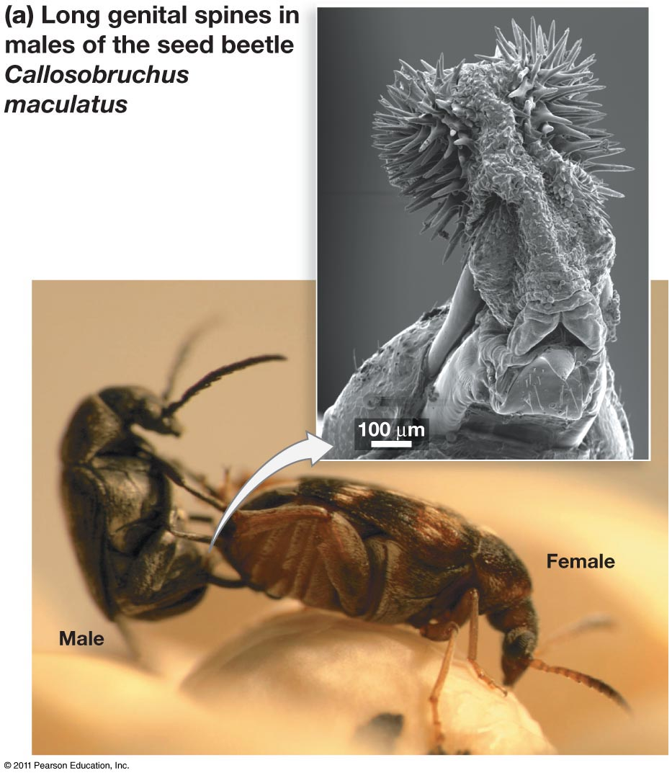
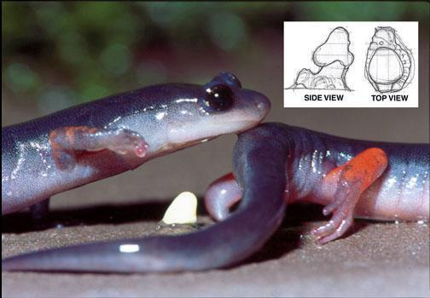
Internal fertilization
How has natural selection affected male behavior and anatomy to increase his chances of passing his alleles on to progeny (to “ensure” paternity)?

Slide 14
Animal Reproduction
Asexual
Both
Sexual
Budding
Fragmentation
Polyembryony
Parthenogenesis
External fertilization
Internal fertilization
Competition
Courtship
Parental investment
Synchronized gamete release
sexual dimorphism
direct male-male aggression
sperm competition
cryptic female choice

Slide 15
Competition for mates
In sexual reproduction, there is always competition for mates (or access to gametes)
The only variation is whether competition occurs before mating or after mating
The only exception is absolute “true” monogamy, where every individual is guaranteed a mate

Slide 16
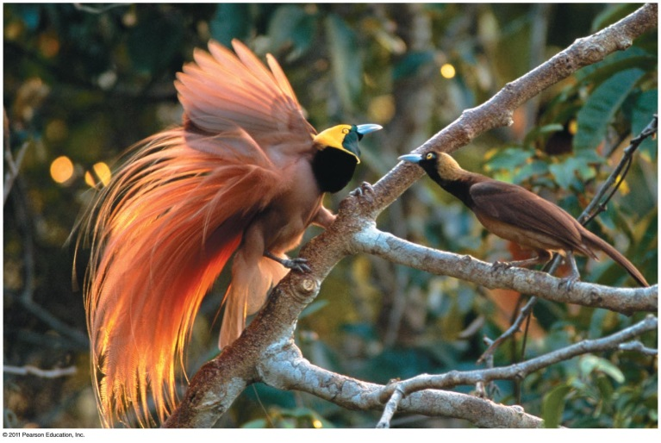
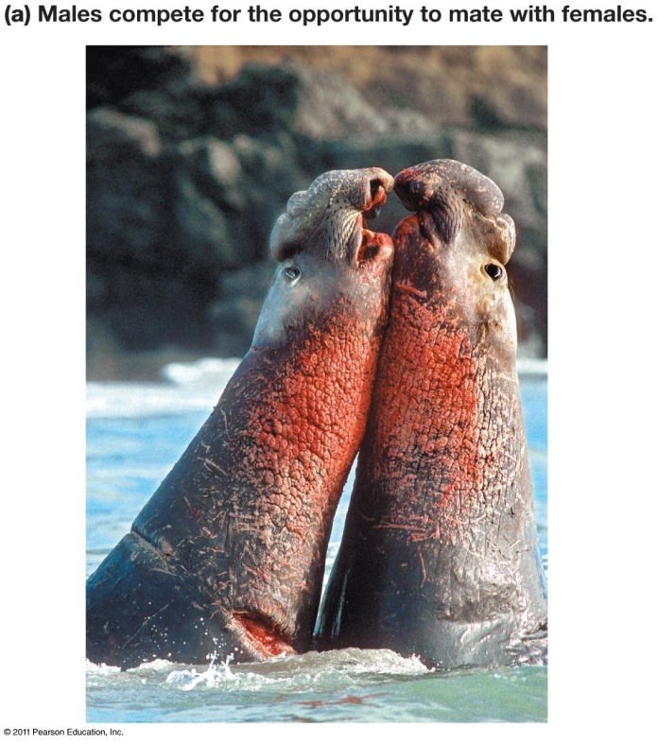
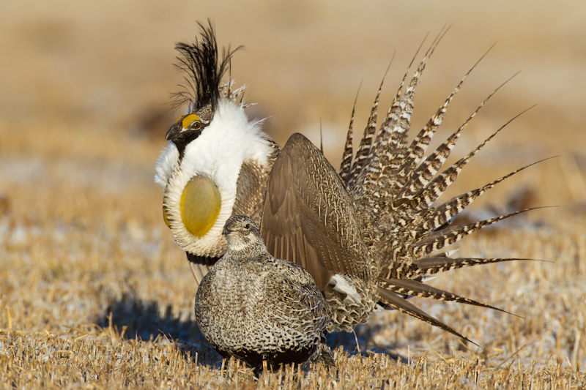
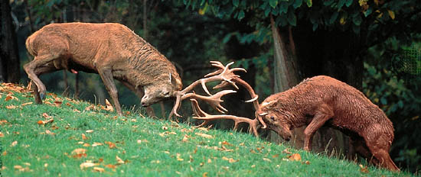
Direct male competition: courtship, direct male-male aggression, and female choice
“good genes” hypothesis:
Sexually-selected male traits are “honest indicators” of genetic quality
Why does competition occur? Why is it typical for males to compete for females rather than the other way around? What are the exceptions to the rule?
Notes:
Comes down to parental investment

Slide 17
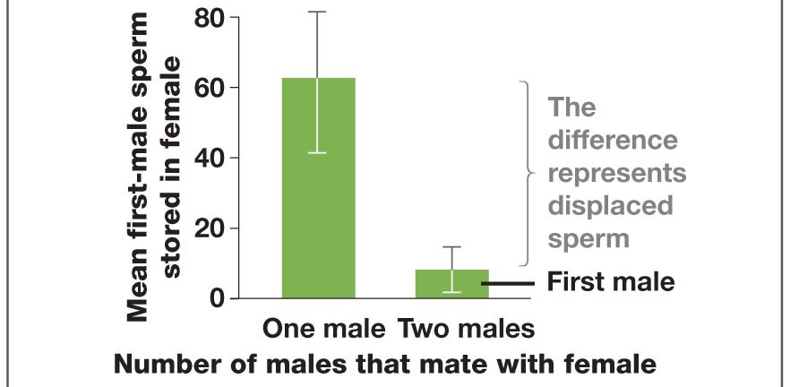
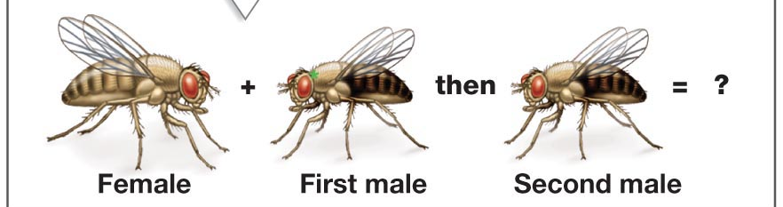
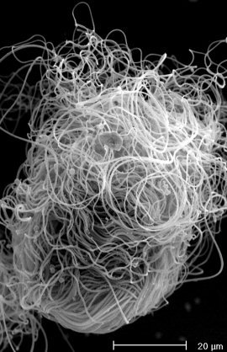
Indirect male competition: sperm competition, mate guarding, copulatory plugs, penis morphology, forced ejection, ejaculate volume
First male advantage
Second male advantage
The above do not take into account the role of cryptic female choice in paternity
D. bifurca sperm
Notes:
Sperm competition is the phenomenon that causes unique behaviors and traits to appear via sexual selection (e.g. mate guarding, copulatory plugs)
Mate guarding: The advantage of preventing multiple matings in female has to outweigh loss of opportunity to mate with other females
Female anatomy may also affect sperm competition in the complex structure of sperm transport and storage organs
Some species have evolved elaborate structures on the penis to remove previous males’ sperm. Some actually cause harm to the female (why? Perhaps to ensure that the female is motivated to lay her eggs quickly, before mating with another male).
Some species have males that produce great quantities of ejaculate to dilute previous male’s sperm. Forced ejection occurs in birds, when a male suspects he’s been cuckolded by his mate, he pecks on her cloaca [reproductive opening] and the physiological response is that the female ejects the sperm.

Slide 18
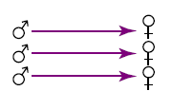
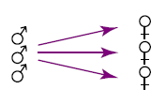
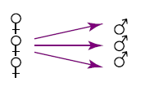
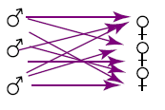
Mating systems: who “monopolizes” or “accumulates” whom?
Monogamy
Polygyny
Polyandry
Promiscuity
A particular species’ mating system is shaped by:
Ecological factors
Societal structure
Evolutionary history
Adapted from Wolff and Macdonald, TRENDS in Ecology and Evolution 2004
http://bio.research.ucsc.edu/~barrylab/classes/animal_behavior/MATESYS.HTM#anchor594574
Notes:
Females choose their limiting resource which is food and males choose theirs which is females. So males will always be under selection to monopolize multiple females. For instance whether they'll be able to get access to females depends on how females are dispersed in space and in time. If they're evenly distributed in space, it'll be hard to hold on to more than one female so there's little potential for polygamy. But if resources, and therefore females, are clumped then one male can control access to many females. In this case there's a lot of potential for males to remain polygynous.
Also females' distribution in time affects the ability of a single male to monopolize all females- if they are synchronized in breeding /estrous, then it's more difficult for a single male to monopolize females since they're all receptive at once and it's too easy for other males to sneak in while he's mating with one. If estrous is spread out in time then it's easier for the same male to monopolize the few females who are ready at each time. Note that these two kinds of clumping have the opposite effect of each other. Synchrony reduces defendability of mates while spatial clumping increases defendability.

Slide 19
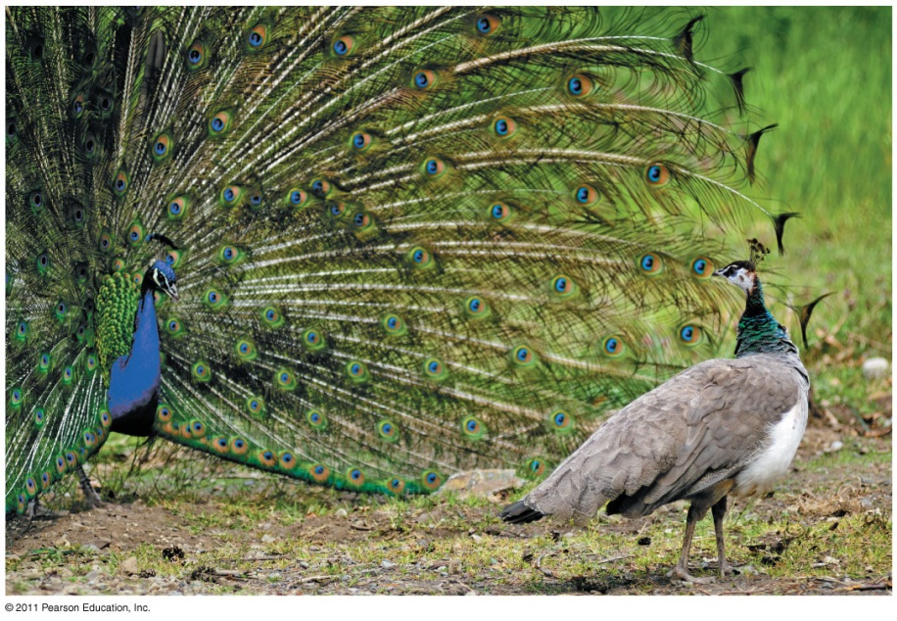
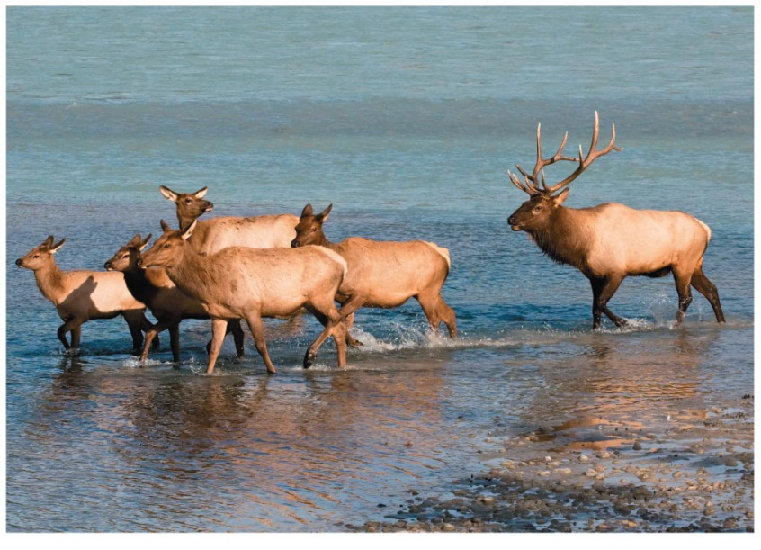
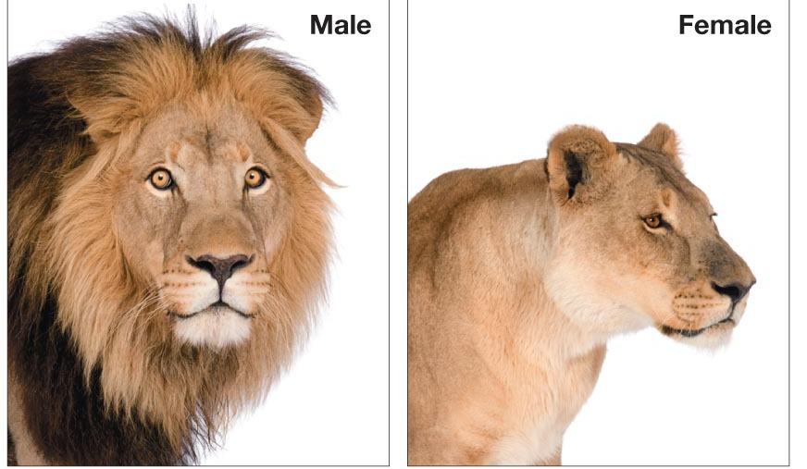
Polygyny
Two variations:
Male controls territory where females aggregate or male controls access to female group; females are not all receptive to mating at the same time
Lek: males congregate for display and females choose
Notes:
Females live in groups, 1 male per female group
Male has large resource-rich territories, females live in it
Females live together, males compete directly for access to harems; high infanticide upon change in male
Males gather to display (leks) in mini-territories, females choose
1. It must be economically feasible for males to defend females. (Costs vs. Benefits.) 2. Males must be able to capitalize on potential for polygyny. This depends on characteristics that have evolved in their phylogeny, for instance, how much male parental care is required to raise offspring. So, there might be high polygyny potential, but males might not be free to take advantage of it because babies will die without their contribution. Ecological factors determine both EPP and ability to capitalize on the EPP. Phylogenic factors also determine how well the male can capitalize on the EPP. Economic feasibility and capitalization ability both determine the degree of monopolization of mates which determines mating system.

Slide 20
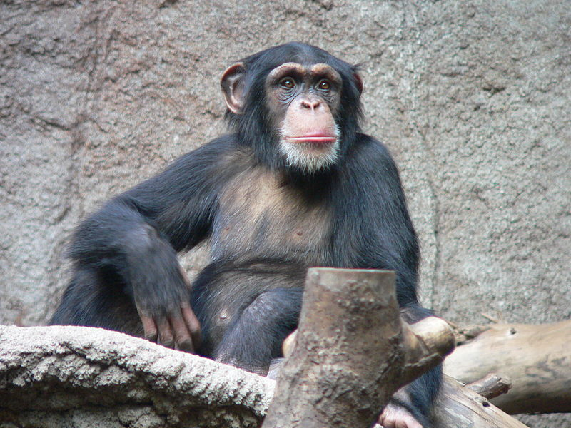
Promiscuity
Large social groups, all females receptive to mating at the same time
Paternity unknown
Chimpanzee
Notes:
Unknown paternity protects against infanticide
Live in social groups, everybody mates with everybody
Generally happens when males don't succeed in monopolizing access to any females. This may be because of the minimal mammalian social system where males are ranging widely through the home ranges of several females. Because they don't have defended territories, they can't monopolize any females. This is seen in the orangutans as well as some prosimians.It also happens in large groups with multiple males and females. There may be two factors happening- it may not be economically feasible to restrict access to a large group, too big a job for one male. It has also been suggested that in like chimps and maybe marikis(brachyteles) it's that males need to reduce aggressive interactions between themselves because they've got to cooperate to defend joint territory from outsiders. They suppress their natural competition otherwise they'd all lose all the females. At least when they share they get some females. So this is all why males might be into promiscuity. What do the females get out of it?
Females must have a reason for mating with more than one male, too. Females' reasons haven't been studied as much. One reason might be to ensure fertilization. Also it might confuse paternity so it's not sure which male fathered her offspring so they're less likely to kill the kid. Or, maybe it's easier for a female to just mate with a male than to be subjected to aggression if she refuses.

Slide 21
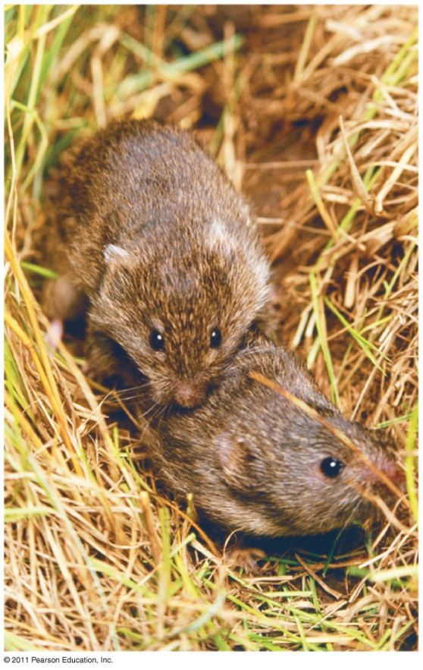
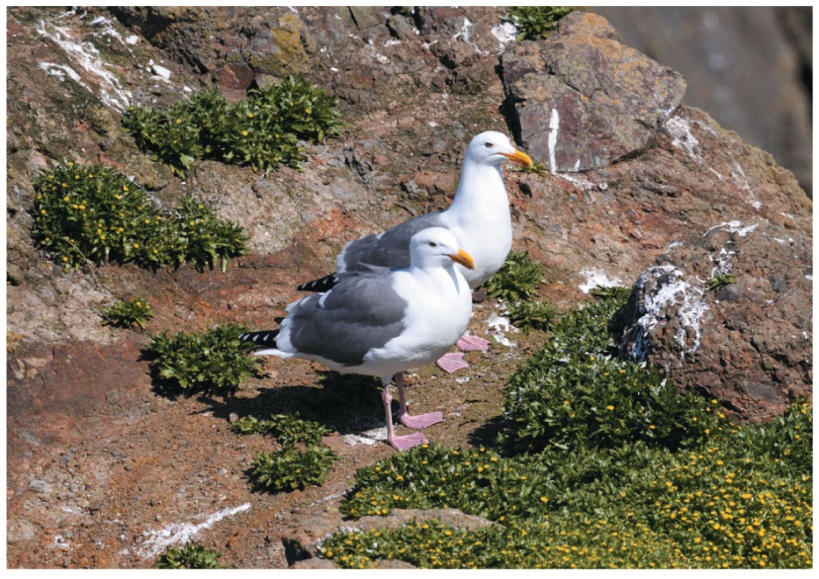
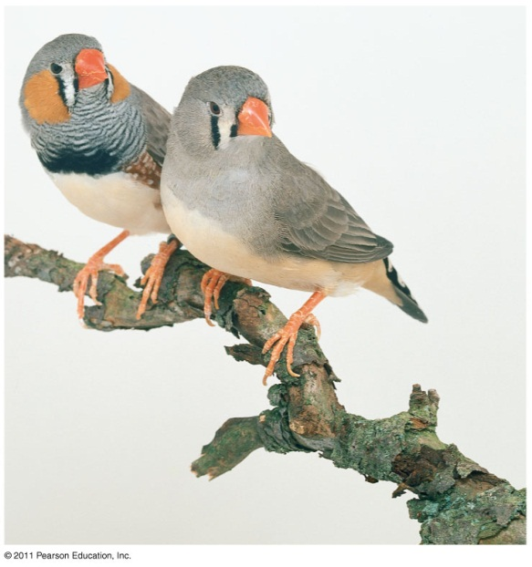
Monogamy
Seagulls
Zebra finches
True vs social monogamy: Which of these species is not truly monogamous?
How can you tell?
Prairie voles
Notes:
Mate guarding vs mate assistance
Paternal investment
Distributed resources
Social monogamy/’cheating’
Little sexual dimorphism
Ok, so if polygyny is so great then why do some end up being monogamous? It's certainly not very common: Birds- 90% monogamous (often social). Mammals- under 5% monogamous Primates- 37/200=~18% monogamous. (Traditional human societies are about 20% monogamous.)Characteristics of monogamous primates
Limited mating opportunities
Male investment in offspring is high
Male confidence in paternity is high (we're just talking probability here, not mental awareness)
Little sexual dimorphism
Territoriality & sex-specific aggression
Hypothesis for the evolution of monogamy
Evolves when males can only economically defend one female. This could be because of ecological constraints or because of the demands of parental care. Quite different from birds where parental care is the main factor. Someone always has to be brooding the eggs so they have to take turns so they can eat. This doesn't apply to primates so monogamy is driven more by the spatial distribution of females. Usually it's just too hard for males to defend more than one female.

Slide 22
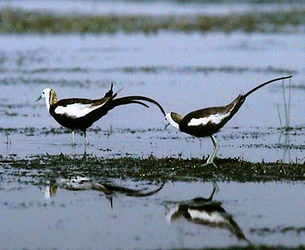
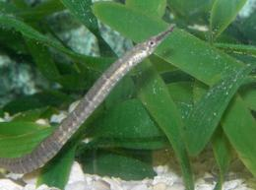
Polyandry
Northern jacana
Which is the female?
Pipefish
Notes:
Multiple males raise a clutch, role reversal
Pipefish: male has post-copulatory control; digests eggs of unattractive females
Polyandry
Rare in mammals in general, but occurs facultatively in tamarins. Data from six populations of saddleback tamarins studied over 4 years. Percentage of groups displaying each type of composition: (X=multiple) 1f-1m 22% 1f-Xm 61% Xf-Xm 14% single-sex 3%So maybe they're not completely polyandrous but it's the most common result. This may occur because they have unusual reproductive biology. For one thing they usually have twins. Offspring are quite large at birth; their combined weight can be up to 25% of the mother's weight. (OUCH!) By the time they wean, each offspring is about half the size of the mother. So she's providing enough milk to provide enough for two who together weigh as much as her! So females don't usually even carry offspring after second week. Males do this, or previous offspring. So males do much more carrying and seem to be completely necessary especially to escape from predators. Male parental care is limiting to reproductive success, and it's even higher with more than one male helping, so sometimes it takes two males just to raise one female's offspring.
Reverse sexual dimorphism, females compete for males

Slide 23
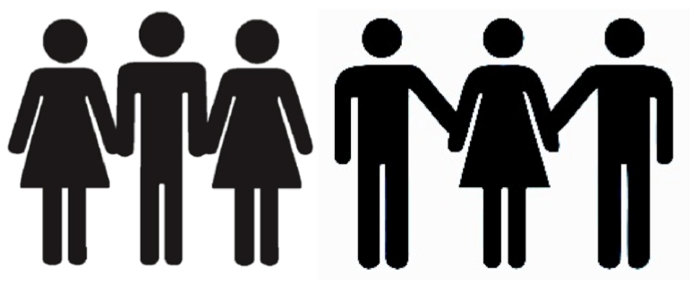
Monogamy and Fitness
Fitness: reproductive success relative to others in the population
If sex leads to greater fitness in a variable environment (i.e. resistance to parasites or pathogens), that leads to the question: what sexual mating system may lead to greater fitness?

Slide 24
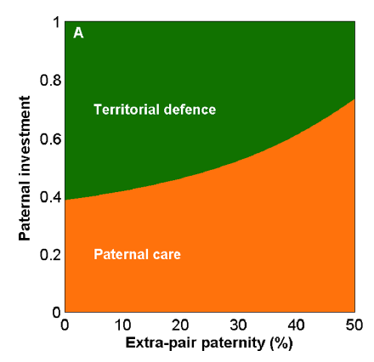
Monogamy and Fitness
Fitness: reproductive success relative to others in the population
Modeling relationships between:
Parental investment
extra-pair paternity
paternal care
territorial defense against other mate pairs
A male must divide his time between defending his territory and caring for his offspring
What does this model imply? There is a trade-off: monogamy leads to less energy invested in parental care.
Figure 1. Extra-pair paternity (EPP) favours reduced territorial aggression between neighbours. (A) Evolutionarily optimal male investment strategy in territory defense (green area) versus care (orange) as function of EPP.

